Slide 1
What was 1880’s Whitechapel like?
LO: to be able to analyse what it would be like to live in Whitechapel in 1888

Slide 2
Learning outcomes
LO: to be able to analyse what it would be like to live in Whitechapel in 1888
All will be able to describe what it would be like to live in Whitechapel in 1888 L4
Most will be able to evaluate the impact of population and geography on life in Whitechapel L5
Some will be able to analyse how the conditions in Whitechapel made crime more likely L6

Slide 3
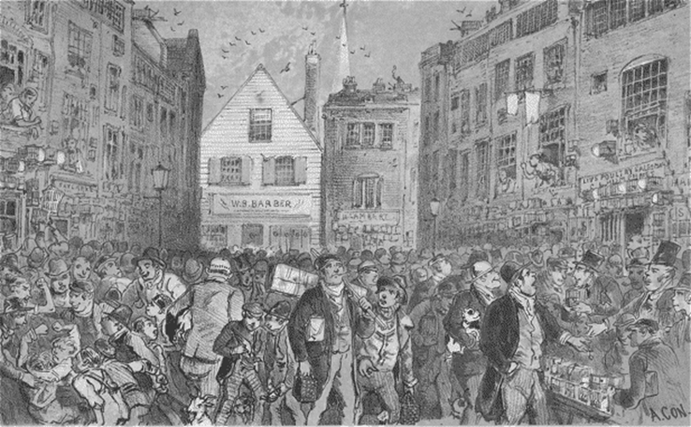
The east end in 1888
LO: to be able to analyse what it would be like to live in Whitechapel in 1888
All will be able to describe what it would be like to live in Whitechapel in 1888 L4
Most will be able to evaluate the impact of population and geography on life in Whitechapel L5
Some will be able to analyse how the conditions in Whitechapel made crime more likely L6
London in 1888 was a divided city.
Just like today, the West End was the wealthiest area, and the East End was much poorer.
Jack the Ripper operated in the East End, for a variety of reasons.

Slide 4
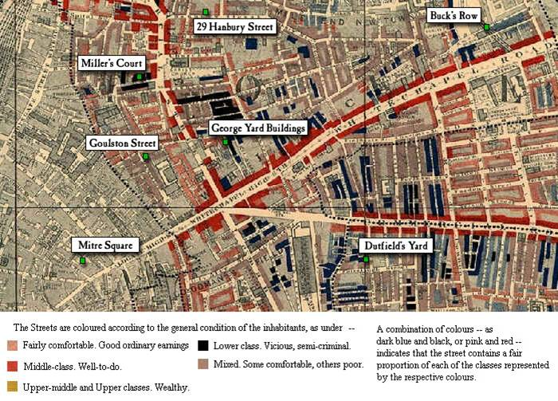

Slide 5
Task 1
LO: to be able to analyse what it would be like to live in Whitechapel in 1888
All will be able to describe what it would be like to live in Whitechapel in 1888 L4
Most will be able to evaluate the impact of population and geography on life in Whitechapel L5
Some will be able to analyse how the conditions in Whitechapel made crime more likely L6
In your books write a list (or draw a mind map) of the words you could use to describe what it was like to live in Whitechapel in 1888.

Slide 6
So why was Whitechapel so useful for crime?
LO: to be able to analyse what it would be like to live in Whitechapel in 1888
All will be able to describe what it would be like to live in Whitechapel in 1888 L4
Most will be able to evaluate the impact of population and geography on life in Whitechapel L5
Some will be able to analyse how the conditions in Whitechapel made crime more likely L6
There are 3 reason why Whitechapel was a good place to commit crime. These were:
Pollution
Housing
Social life

Slide 7
Reason 1 = Pollution
LO: to be able to analyse what it would be like to live in Whitechapel in 1888
All will be able to describe what it would be like to live in Whitechapel in 1888 L4
Most will be able to evaluate the impact of population and geography on life in Whitechapel L5
Some will be able to analyse how the conditions in Whitechapel made crime more likely L6
London was an industrial city and as such suffered from pollution.
The smoke and stinking gas fumes choked the streets so badly that at times it was not even possible to see your own hand in front of your face, this was known as smog (smoke and fog = smog!)
These smogs were called “Pea Soupers” because of their greenish colour.

Slide 8
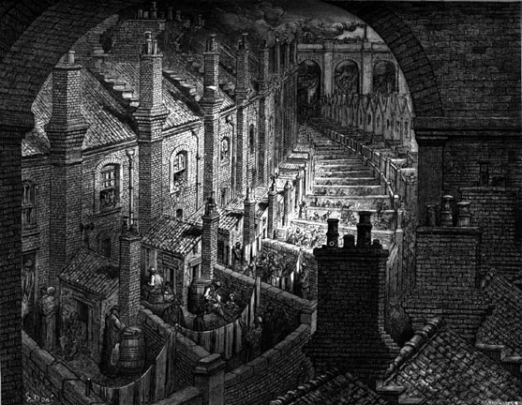
LO: to be able to analyse what it would be like to live in Whitechapel in 1888
All will be able to describe what it would be like to live in Whitechapel in 1888 L4
Most will be able to evaluate the impact of population and geography on life in Whitechapel L5
Some will be able to analyse how the conditions in Whitechapel made crime more likely L6
The houses in areas such as Whitechapel were always near the railways which were polluting the air!
The Terraced Housing used coal to heat the houses and this meant soot would leave the chimney with the smoke. This would rise up in to the atmosphere and then land back down.

Slide 9
Reason 2 = Housing
LO: to be able to analyse what it would be like to live in Whitechapel in 1888
All will be able to describe what it would be like to live in Whitechapel in 1888 L4
Most will be able to evaluate the impact of population and geography on life in Whitechapel L5
Some will be able to analyse how the conditions in Whitechapel made crime more likely L6
In the poorer areas of the city such as Whitechapel the housing was terrible.
There was no sanitation and sewage ran openly through the overcrowded, maze-like streets.
Added to this there were very few street lamps in the poorer areas.

Slide 10
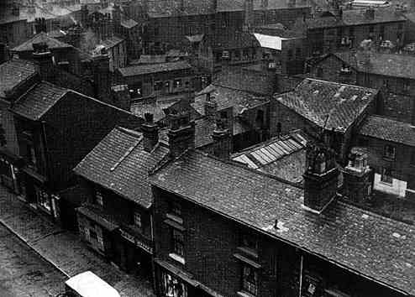
So why was Whitechapel so useful for crime?
LO: to be able to analyse what it would be like to live in Whitechapel in 1888
All will be able to describe what it would be like to live in Whitechapel in 1888 L4
Most will be able to evaluate the impact of population and geography on life in Whitechapel L5
Some will be able to analyse how the conditions in Whitechapel made crime more likely L6

Slide 11
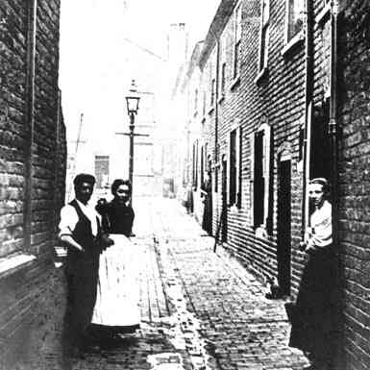
LO: to be able to analyse what it would be like to live in Whitechapel in 1888
All will be able to describe what it would be like to live in Whitechapel in 1888 L4
Most will be able to evaluate the impact of population and geography on life in Whitechapel L5
Some will be able to analyse how the conditions in Whitechapel made crime more likely L6

Slide 12
Reason 3 = Social life
LO: to be able to analyse what it would be like to live in Whitechapel in 1888
All will be able to describe what it would be like to live in Whitechapel in 1888 L4
Most will be able to evaluate the impact of population and geography on life in Whitechapel L5
Some will be able to analyse how the conditions in Whitechapel made crime more likely L6
There was also little work available for women, and no help for those women who were unemployed other than the workhouse.
Many were forced to become prostitutes to survive.

Slide 13
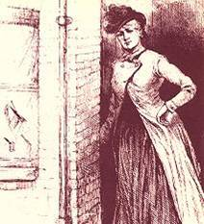
Prostitution
LO: to be able to analyse what it would be like to live in Whitechapel in 1888
All will be able to describe what it would be like to live in Whitechapel in 1888 L4
Most will be able to evaluate the impact of population and geography on life in Whitechapel L5
Some will be able to analyse how the conditions in Whitechapel made crime more likely L6
There were probably over 90,000 ‘part-time’ prostitutes.
These were women forced to go on the streets to make ends meet. All the victims that Jack killed were these type of prostitutes.

Slide 14
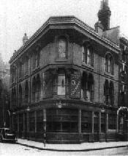
LO: to be able to analyse what it would be like to live in Whitechapel in 1888
All will be able to describe what it would be like to live in Whitechapel in 1888 L4
Most will be able to evaluate the impact of population and geography on life in Whitechapel L5
Some will be able to analyse how the conditions in Whitechapel made crime more likely L6
For many such women, their only escape from their terrible lives was drink, especially gin, and they quickly became helpless alcoholics.
The Whitechapel area had a large amount of Pubs and Inns to profit from the poverty and depression of the people.

Slide 15
Task 2
LO: to be able to analyse what it would be like to live in Whitechapel in 1888
All will be able to describe what it would be like to live in Whitechapel in 1888 L4
Most will be able to evaluate the impact of population and geography on life in Whitechapel L5
Some will be able to analyse how the conditions in Whitechapel made crime more likely L6
write a diary entry for someone who was living in the East end or report from someone visiting the area on what life was like in Whitechapel.
Things to include:
Houses – what were they like how many people lived in them
Sanitation – smell
Type of people who lived there
Diseases and general health
Crime – why crime was problem, how environment effected the volume of crime in Whitechapel

