Slide 1
Germany Recovers: The Stresemann Years
WALT: How successfully did Stresemann solve the problems of Weimar 1924-1929?
Remember; To copy out today’s WALT
WILFs
Can describe and explain problems and
Solutions (C)
Can assess how successful Stresemann was (A)

Slide 2
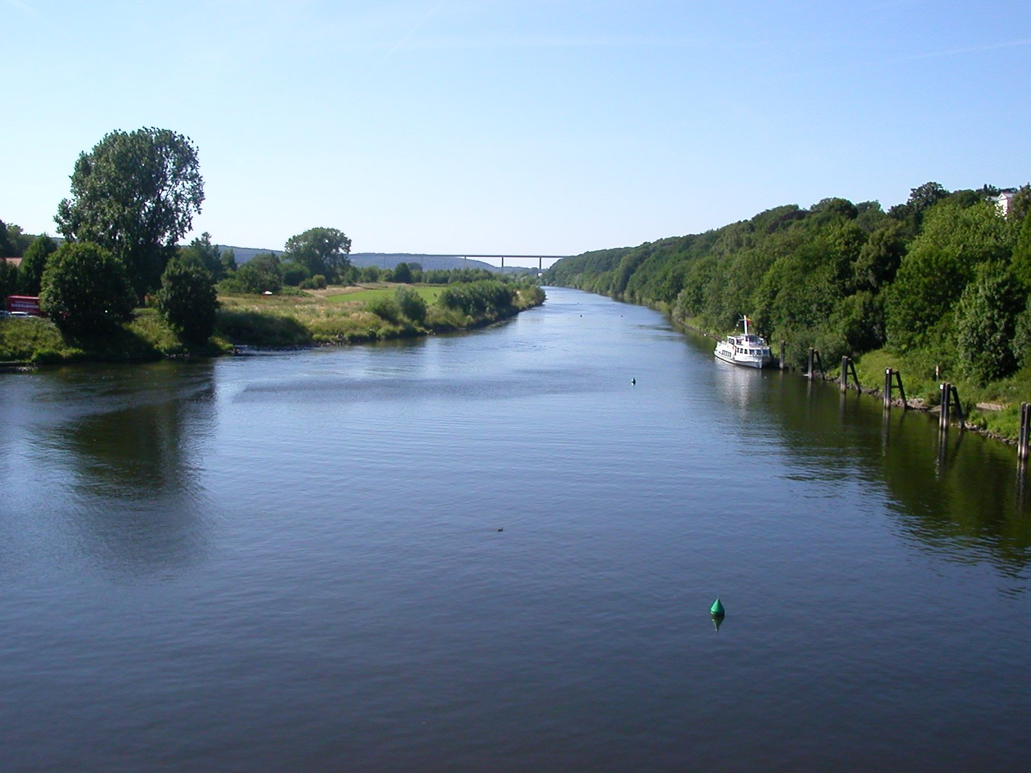
Problem 1: French troops in the Ruhr
French troops had invaded because Germany had not kept up their reparation payments.
A
B
C
Stresemann, you must meet up with the Americans and ask them to reduce the reparation payments.
No! Invade the Ruhr and fight the French forces. You may only have 100,000 soldiers left but it should be enough.
Refuse to pay reparations any more; you can’t afford it can you?

Slide 3
Problem 1: French troops in the Ruhr
And the scores are..
A
B
C
10 points
30 points
20 points

Slide 4
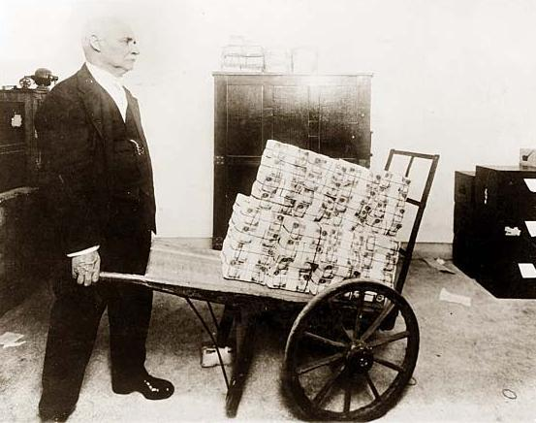
Problem 2: Hyperinflation
Money had become worthless
People’s lifelong savings had been lost
A loaf of bread cost …
Do you
C
A
B
Wait for the currency to recover by itself. That way all those people’s savings will become worth something again.
Print higher value notes. (e.g. 2 billion, 3 billion etc). That way people won’t have to use wheelbarrows to carry their money anymore.
Invent a new currency and use it to completely replace the old German mark

Slide 5
Problem 2: Hyperinflation
And the scores are….
A
B
C
30 points
10 points
20 points

Slide 6
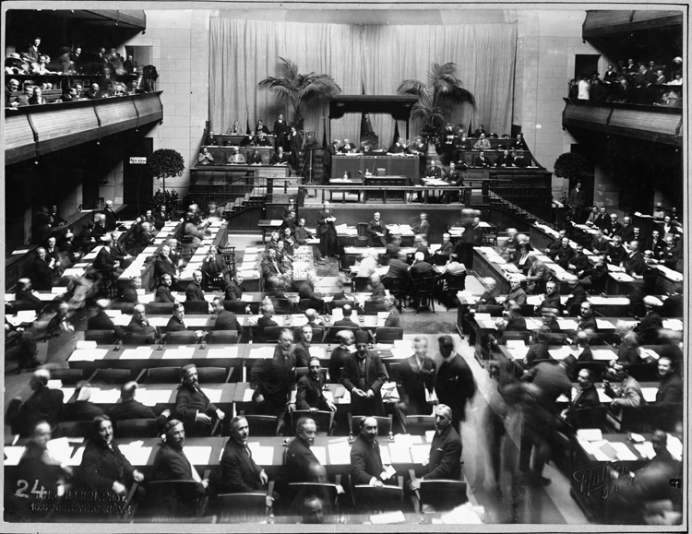
Problem 3: No one trusted the Germans
Other countries don’t want to make alliances with Germany. Germany have been left out of the League of Nations
A
B
C
I know we’ve been banned from the Anchluss (making alliances with Austria). But they are our natural ally. We need to make the Anchluss once more
We want to rebuild the German Empire. That way we can defend ourselves from our enemies.
We can get involved with lots of peace treaties with other countries. Let’s join the League of Nations too! Just sign on the dotted line….

Slide 7
Problem 3: No one trusted the Germans
A
B
C
30 points
20 points
10 points

Slide 8
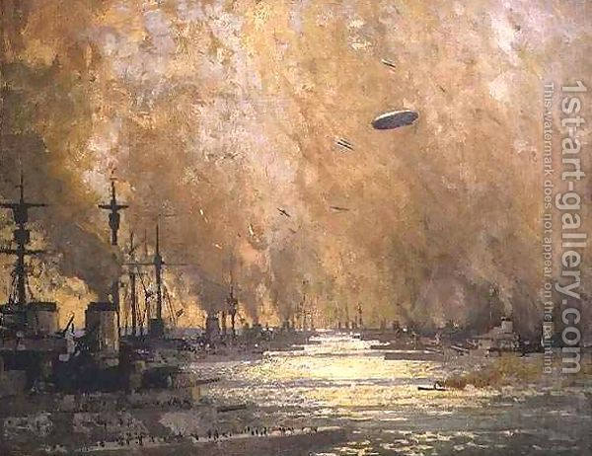
Problem 4:German industry is run down after the Great War
Factories are run down, there are only a few jobs, and poor schools, housing and hospitals.
A
B
C
Organise a MASSIVE loan from America to help pay for new schools, house and hospitals and to create new jobs.
Quietly build up the Germany army. This will help create new jobs.
Let the economy recover on its own- it may be slower, but it is much cheaper and it will recover eventually

Slide 9
Problem 4:German industry is run down after the Great War
Factories are run down, there are only a few jobs, and poor schools, housing and hospitals.
A
B
C
10 points
30 points
20 points

Slide 10
Add up your scores….
40-60 points: Well done! You are Gustav Stresemann. You brought in a new “golden age” in Weimar Germany!
70-90 points: Not great solutions, if you really want to be part of a peaceful Europe. Perhaps you have a future with the Nationalist Party, the Nazis…
100-120 points: Your ideas were very similar to those of Adolf Hitler. They were also what some Germans wanted- although the Nazi party was not yet very popular.
Probably, your solutions would ultimately led to war…

Slide 11
Problems | Stresmann’s solution: how good was it?
Hyperinflation | 
French occupation of the Ruhr | 
Germany’s poor relationship with other countries | 
German industry is in trouble | 

Slide 12
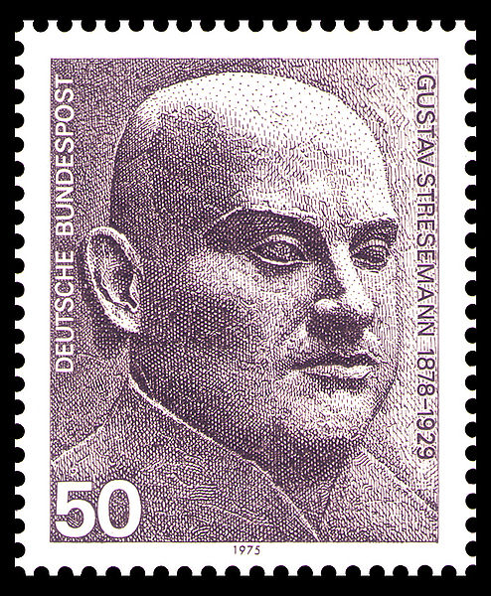
Did Stresemann deserve his Nobel Peace Prize?
In 1926 Stresemann was awarded the highly respected Nobel Peace Prize
He had helped Germany get back on its feet industrially, and helped solved the hyperinflation crisis- but through MASSIVE loans from America
He had started to make alliances with the rest of Europe- but not all Germans thought that was right
He had improved the lives of Germans; Berlin was now the place to be seen, and schools and houses had been improved- but this had increased the debt to America.

