Slide 1
WALT: What happened in England in 1066?
WILFS:
3 – Place the context of today’s lesson into chronological order.
4 – Describe our origins, where we came from.
5 – Explain4 things that happened in England in 1066.

Slide 2
STARTER: Chronology
Chronology means in order of time…
PLACE THESE EVENTS INTO CHRONOLOGICAL ORDER…
2000 BC
YEAR 0
2014 AD
Great fire of London
1666 AD
Celts arrive in Britain
800 BC
Romans arrive
43 AD
Black Death
1348 AD
Vikings arrive.
800 AD
Last Ice Age
10,000 BC
Saxons arrive.
500AD
Normans arrive.
1066 AD

Slide 3
STARTER: Chronology
Chronology means in order of time…
PLACE THESE EVENTS INTO CHRONOLOGICAL ORDER…
2000 BC
YEAR 0
2014 AD
Last Ice Age
10,000 BC
Romans arrive
43 AD
Vikings arrive.
800 AD
Black Death
1348 AD
Celts arrive in Britain
800 BC
Saxons arrive.
500AD
Normans arrive.
1066 AD
Great fire of London
1666 AD
How did you do? Hold up Green for all right and Red for one wrong.

Slide 4
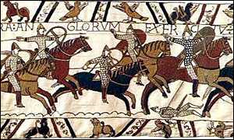
What happened in England in 1066?
Promenade your partner and share what you already know know
Stand and Share
Watch the clip and try and write down 4 things that happened to England in 1066
http://www.youtube.com/watch?v=MizcAkqYOKw

Slide 5
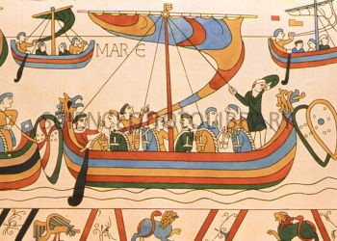
Homework
Complete all questions on the worksheet given out today

