Slide 1
WALT: Decide who might be king…
STARTER: Arrange the image as a table and discuss.
Who do you think you are?
What job did you have?
Why have you been drawn that way?
Where are you from? England?
WILFS
3 – List the contenders to the throne.
4 – Describe who might be the next king of England.
5 – Explain why they had a claim to the throne.
6 – Compare their claims, who had the best?

Slide 2
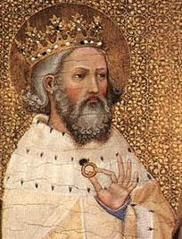



Edward the Confessor.
In January 1066, Edward the Confessor died. The problem was he had no children to take over from him. The witan (council) had the job of deciding who would be the next king.
YOUR TASK
You are a member of the council (witan) and it is your job to choose a new king.
Q. RALLY TABLE – WHAT MAKES A GOOD KING, WHAT QUALITIES WOULD YOU NEED

Slide 3
TASK: Who should be king…
You have ten minutes to collect as much information about the 3 candidates as you can.
You need to complete the sheet of information…

Slide 4
TASK
Remember what makes a good king.
Discuss and then write…
Q. Decide who you think the witan should select as King of England and why?
I think that ……, he was ……. (4) has the strongest claim to the throne because ……. (5).
However …… could also be king because ….(5/6)
I still think that … had the better claim because… (6b)
DESCRIBE what their claim was!
EXPLAIN why their claim was strongest…

Slide 5
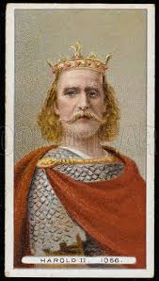
Harold
Godwinson
If you chose Harold Godwinson well done! Give yourself 10/10. Harold was the Witan’s choice. He was English and an experienced soldier. He understood how England should be governed.

Slide 6
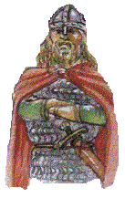
Harald
Hardraada
If you chose Harold give yourself 7/10. He was a great warrior and an experienced ruler. But to the English he was a foreigner and they didn’t want to be ruled by a foreigner.

Slide 7
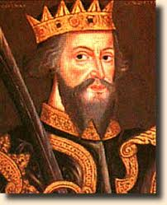
William
of Normandy
If you chose William give yourself 7/10. He was an experienced ruler and a skilled warrior but like Harald Hardraada he was a foreigner.

Slide 8
QUIZ
WHO WAS HH ?
WHO WAS HG?
WHAT WAS WILLIAMS CLAIM?
WHO PROMISED THE THRONE TO WILLIAM?
WHO WAS EtC ?
WHO WAS EtC’s DEPUTY?

Slide 9
Name:
Title:
From:
What is his claim to throne:
Does he have Support?
Is he a good fighter?
Problems?
Name:
Title:
From:
What is his claim to throne:
Does he have Support?
Is he a good fighter?
Problems?
Name:
Title:
From:
What is his claim to throne:
Does he have Support?
Is he a good fighter?
Problems?

Slide 10
Name: H H
Title:
From: Norwegian
What is his claim to throne:
Does he have Support? Had
support of Tostig,
Harold Godwinson’s brother
Is he a good fighter?
Problems?
Name: H G
Title: E
From:
What is his claim to throne:
Does he have Support?
Is he a good fighter? Very
good
Problems?
Name:
Title: Duke of
From: France
What is his claim to throne:
Does he have Support? He has the support of the pope.
Is he a good fighter?
Problems? Claims Harold Godwinson had promised him the throne in 1051.

Slide 11
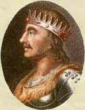
Harold, Earl of Wessex, was the late King’s brother-in-law.
He was English and had been Edward the Confessor’s deputy, so he held a lot of power in England.
He was a very good fighter.
He claimed Edward the Confessor promised him the throne on his deathbed.
He has the support of the Archbishop of Canterbury.

Slide 12

William, Duke of Normandy had some royal blood because he was second cousin to Edward the Confessor.
He was French
He had a good record as a soldier
He claimed Edward had promised him the throne in 1051.
He claimed Harold Godwinson had promised to support him in 1064.
He had the support of the Pope.

Slide 13
Harold Hardraada (Hard Ruler) had some royal blood.
He was Norwegian.
He had a good record as a soldier.
He claimed the throne should be his because the King before Edward had promised his father, Magnus, the throne.
He had the support of Tostig, Harold Godwinson’s brother.

Slide 14
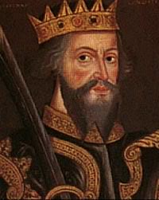

Slide 16
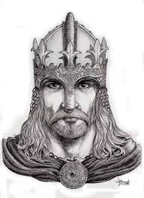

Slide 17
