Slide 1
How did the Nazis treat ‘outsiders’?
www.educationforum.co.uk

Slide 2
Volksgemeinschaft
The idea of the Peoples community was of a healthy, racially pure, vigorous, hard working community of Aryans working for the good of Hitler and the Reich
Those excluded from the Peoples community were called ‘gemeinschaftsunfahig’ and were classified in 3 ways;
Politically – opponents of the regime – communists etc.
Biologically – those who were seen as damaging to the racial purity of the Nation – Jews, mentally ill, gypsies
Socially – those whose behaviour conflicted with Nazi ideas of what was right and proper – alcoholics, prostitutes, homosexuals and the ‘workshy’

Slide 3
The Mentally Ill
The Nazis introduced the Law for the Prevention of Hereditary Diseased Offspring in July 1933
Diseases covered included; congenital feeblemindedness, depression, epilepsy, deafness, physical deformity, schizophrenia, alcoholism
People with such problems were seen as burdens to the community and a threat to racial purity
By law sufferers were sterilised to stop their genes passing to the next generation.
Between 1933-39 350,000 such people were sterilised
From 1939-41 the policy changed to one of ‘mercy killing’ with a special unit called T4 being set up to murder children
Between 1941-44 there were around 200,000 such murders
The T4 programme slowed down in 1941 after the intervention of Archbishop Galen but did not completely stop
The Nazis attempted to prepare people for such policies through propaganda in film and in schools

Slide 4
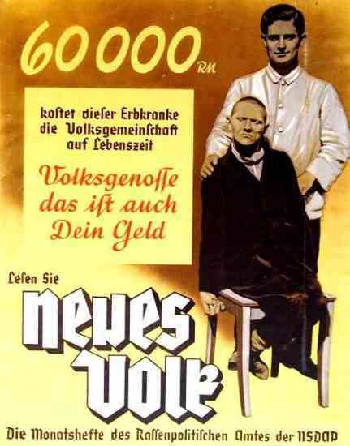
Translation: 60,000 Reich marks. What this person suffering from is hereditary defects costs the People’s community during his lifetime. Comrade, that is your money too.

Slide 5
Asocials
Asocial was a term to describe anyone whose behaviour fell outside of the Volksgemeinschaft including – beggars, alcoholics, addicts, prostitutes, homosexuals, eccentrics, the workshy and delinquents
Refusing to work was seen as an ‘offence against the community’ – repeated refusers were rounded up and sent to Concentration Camps
All asocial behaviour was punishable by imprisonment – Later the Nazis tried to emphasise the biological ‘cause’ of such behaviour to justify their execution

Slide 6
Homosexuals
Homosexuality both offended the Nazis traditional ‘values’ and was seen as a threat to the pro natalist policy
1936 Reich Central Office for Combating Homosexuality and Abortion set up under Himmler
Around 15,000 male homosexuals sent to Concentration Camps – many castrated and others subject to other medical experiments to ‘correct’ their sexual behaviour
Homosexuals frequently received brutal beatings in the camps to ‘correct’ their behaviour and were made to wear the ‘pink triangle’

Slide 7
Religious Sects
The Nazis fiercely persecuted minority religions such as Jehovah’s Witnesses, Christian Scientists, Seventh Day Adventists
Over 1/3rd of all Germany's Jehovah’s Witnesses died in Concentration Camps – often whole families would be arrested
The Nazis were particularly angered by some religious groups refusal to join the army and fight

Slide 8
Gypsies
In 1938 Himmler issued ‘The Decree for the struggle against the gypsy plague’
The Nazis believed that gypsies were racially inferior
The war saw persecution intensify with over ½ million gypsies gassed in Concentration Camps

Slide 9
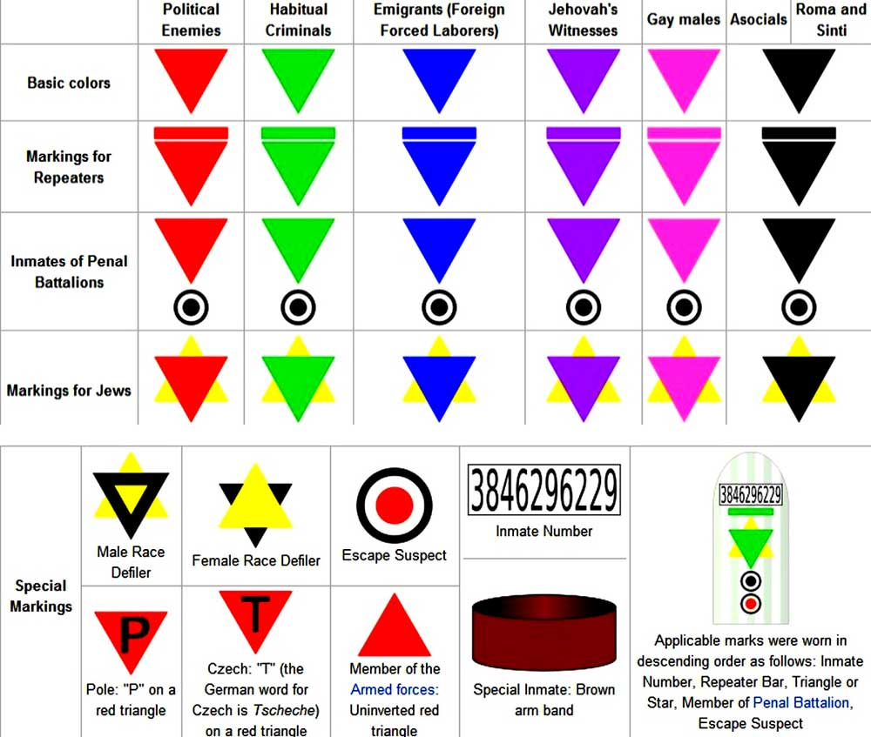
Concentration Camp badges

