Slide 1
Art and Culture in Weimar Germany 1924-29
www.educationforum.co.uk

Slide 2
Cultural Revival
The Stresemann years also saw a big recovery in cultural and artistic life
Artists, architects and writers experimented with new styles and new ideas
There was an atmosphere of free expression and free thinking – Berlin overtook Paris as the European centre for art and culture
Not everyone like the new styles of art

Slide 3
Art
Artists such as George Grosz used his art to criticise both society and politicians. Grosz art was often shocking to respectable society – sometime very political and often very sexual
A new modern art movement called the Dada school also emerged in this period headed by Hannah Hoch

Slide 4
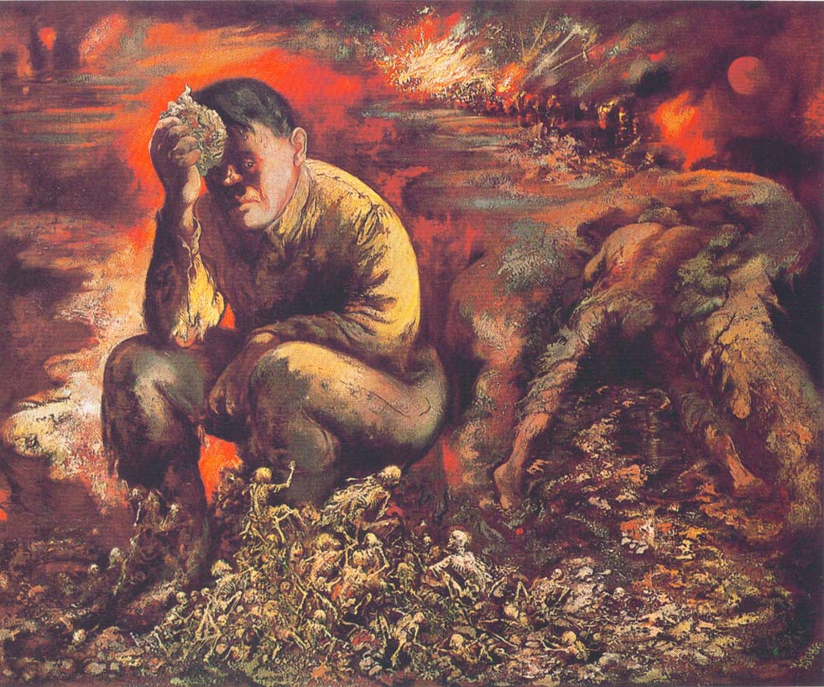
Hitler in Hell

Slide 5
Literature
Berlin also became the centre for new plays, films and operas
Bertolt Brecht the communist playwright became very popular
Cinema took off with films often expressing anti war and anti military ideas
Authors like Erich Remarque wrote any war books like ‘All Quiet on the Western Front’ which sold half a million copies
There were around 120 newspapers and over 40 theatres flourishing in an atmosphere of free expression

Slide 6
Opposition
The Nazis hated the art and culture of Weimar calling it ‘decadent’ and ‘degenerate’ and definitely unpatriotic
Some ordinary people were worried about the apparent decline of moral standards in Berlin where nightclubs and the sex industry flourished

Slide 7
Research Task
Choose two the following and on your table produce a display of their life story and contribution to art and culture:
George Grosz
Hannah Hoech
Walter Gropius
Bertolt Brecht
Hermann Hesse
Erich Remarque
Display on the walls around your table

